Slide 1
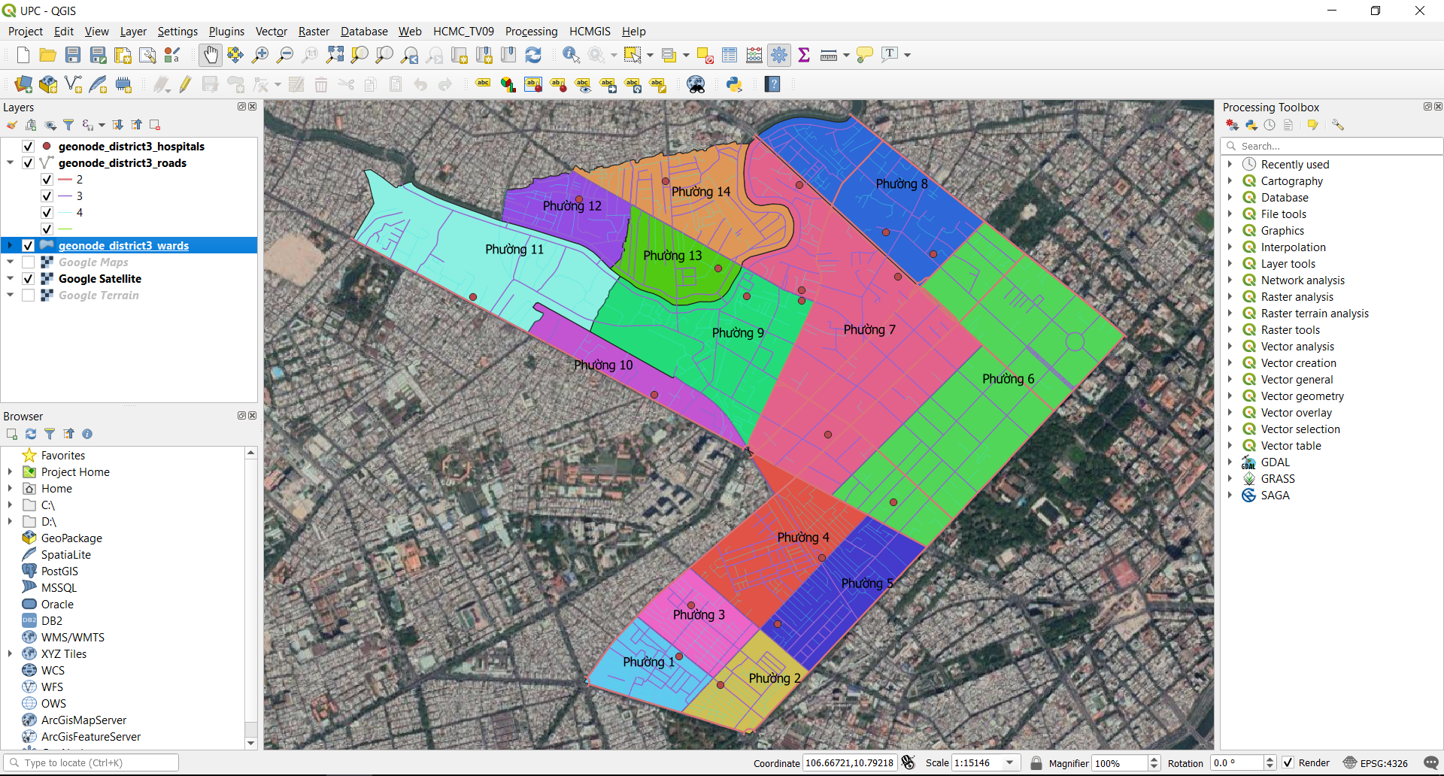
Final Session

Slide 2
Summary and Thank you
Main topics:
Master QGIS GUI
How to install/ update Plugins
Load vector data from various sources
Cartography: Symbology, Label
Understand Coordinate Reference System and how it works in QGIS (define custom projection, Reproject)
Working with Attribute Table: view, query, calculate field,..
Working with spatial features: edit features, spatial query, spatial analysis, spatial processing
Search Processing Toolbox by appropriate keywords
Map Layout Composer

Slide 3
Summary and Thank you
Tip and Tricks:
How to use Bookmarks
Use HCMGIS Plugin for Basemaps, download free and open geospatial data, convert (Vietnamese) Font, define custom Projections, merge/ split layers, merge/ split fields, some geometry processing tools based on Voronoi Diagram.
Advanced Digitizing Toolbar: Only available in projected CRS
Construction Mode
Parallel
Perpendicular
Lock and continuous lock X, Y, Angle, Distance when editing

Slide 4
Summary and Thank you
Useful shortcut keys:
F1: Access QGIS User Guide
F2: Rename active layer
F3: Select Features by Value
F5: Refresh
F6: Open Attribute Table
F11: Toggle Full Screen Mode
Crtl + Tab: Toggle Panels Visibility
Crtl + Ship + Tab: Toggle Map Only
Crtl + K: QGIS Locator Bar (search for algorithms, actions and layer names, select a feature in current active layer by typing an attribute value.)

Slide 5
Summary and Thank you
Final Exam:
Reproject all the wards, roads and hospitals layer to VN – 2000 Projection of HCMC.
Symbology the ward layer by ward name
Label the road with level 1, 2 by road name
Split the hospitals layer to 14 layers by ward name
Clip and extract the road of “Phường 7”
Calculate the population density of each ward (using pop.xlsx)
Find the shortest and longest road
Convert all the attribute in wards layer to UPPER CASE and without accents characters.

Slide 6
Summary and Thank you
Discussion

Slide 7
Summary and Thank you
Congratulations for Achievement Time
https://hcmgis.vn
HCMGIS – GIS for the City, GIS for the Community

